Slide 1
User Guide
How to navigate Transact Games.

Slide 2
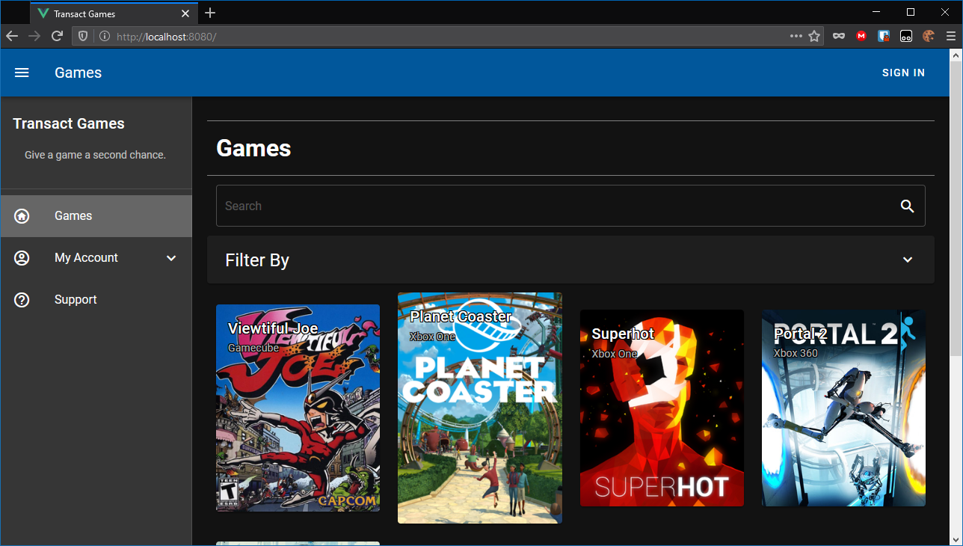
The landing page
Here you see a list of games
You can apply filters by clicking the “Filter By” panel
Search by exact title

Slide 4
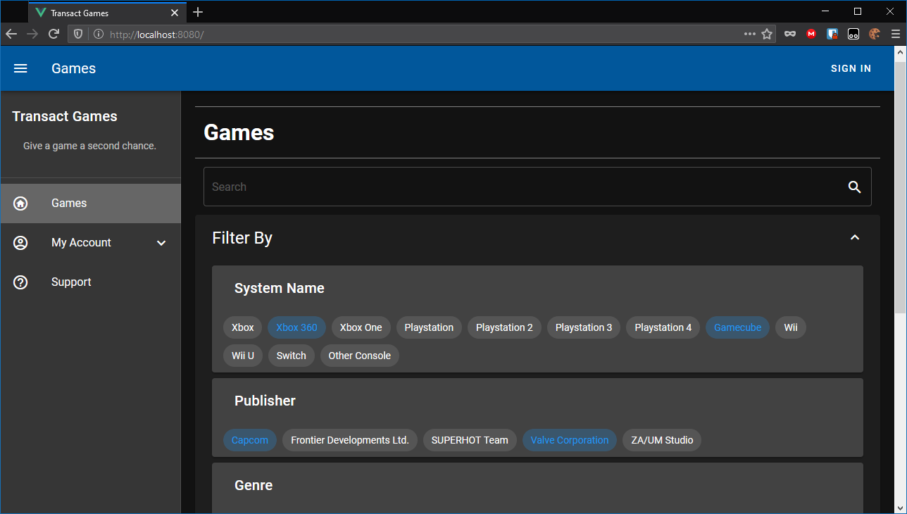
Applying a filter.

Slide 5
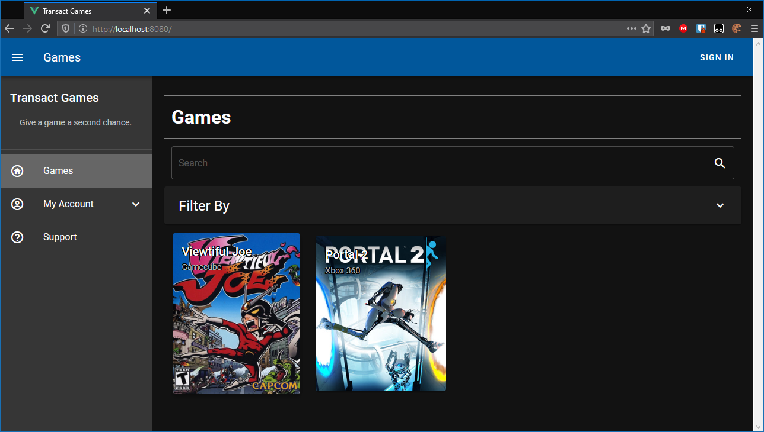

Slide 6
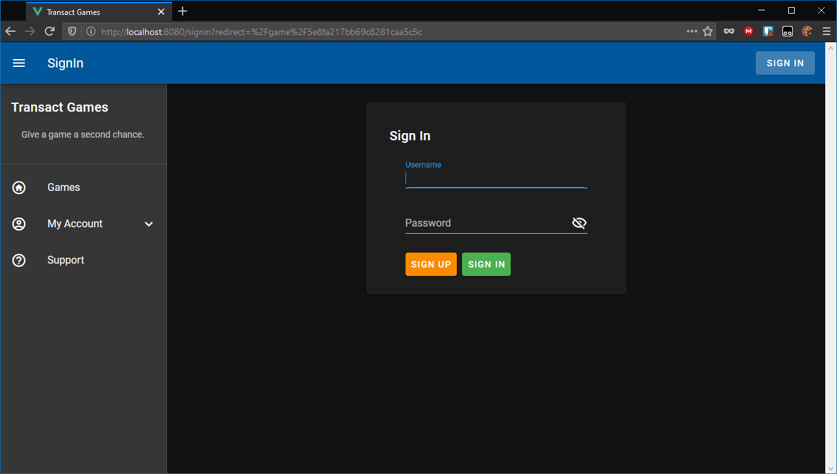
To interact with a game, you must be signed in.

Slide 7
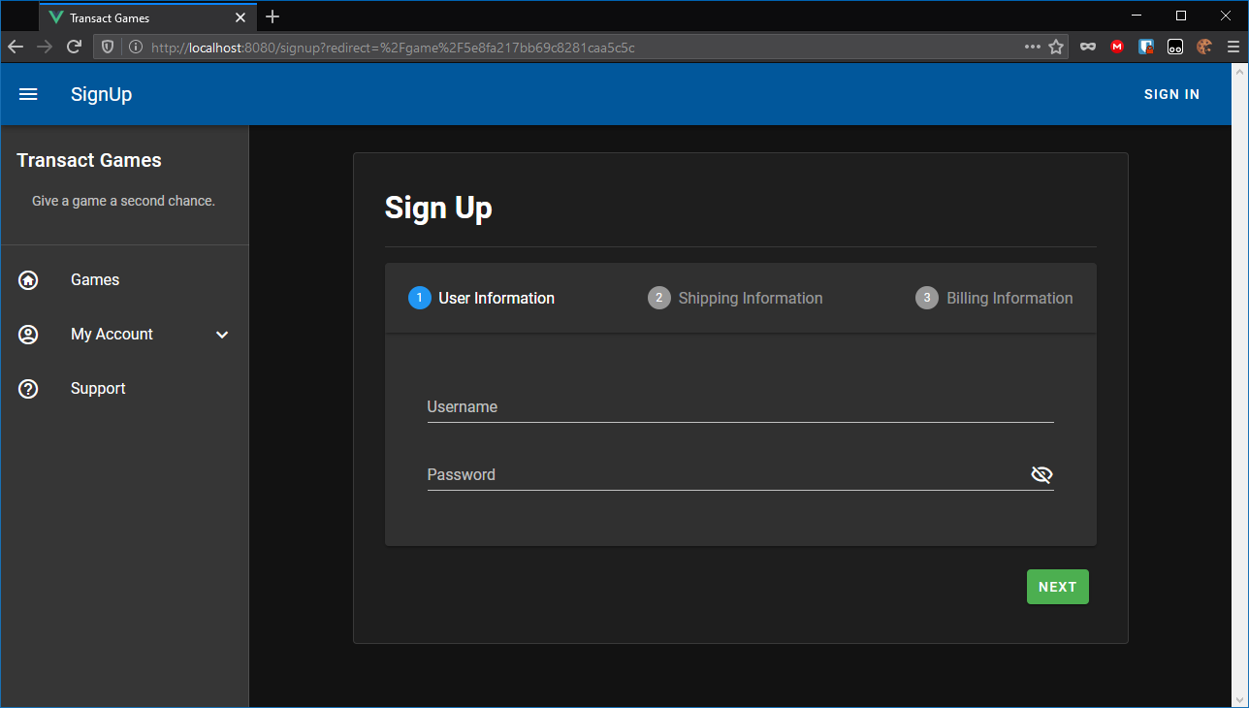
If you do not have an account, you can create one.

Slide 8
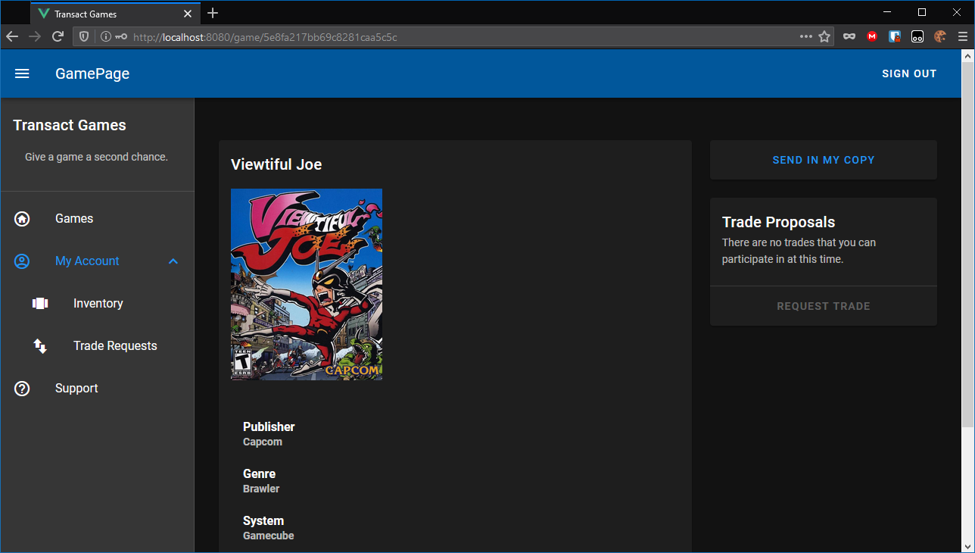
Once you are signed in, you can view the game page.

Slide 9
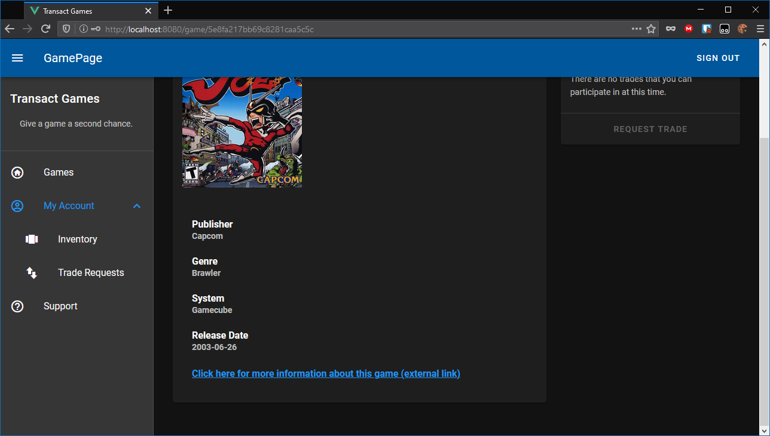
On this page, you can see information about the game.

Slide 10
At the top right, you see the two interfaces for trading.

Slide 11
This button allows users to send in their games so they can trade them.

Slide 12
Outstanding trade requests for this game appear here. An example will be presented later.

Slide 13
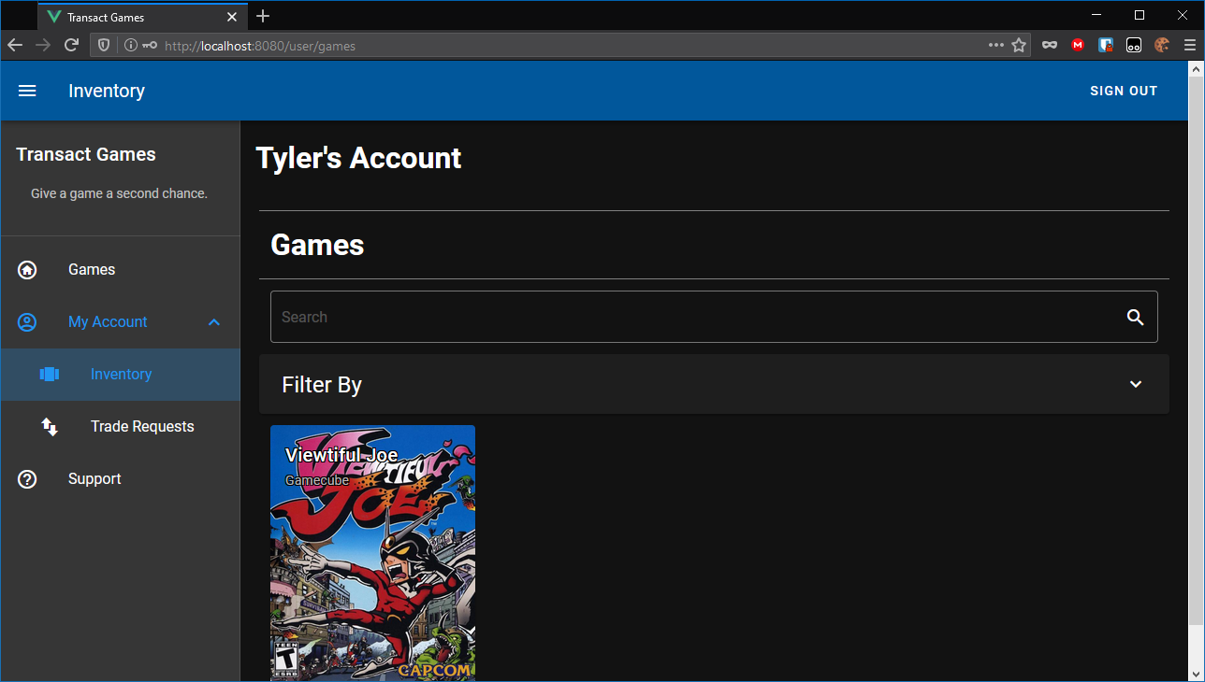
Once you have sent your game in, it will appear in your inventory.

Slide 14
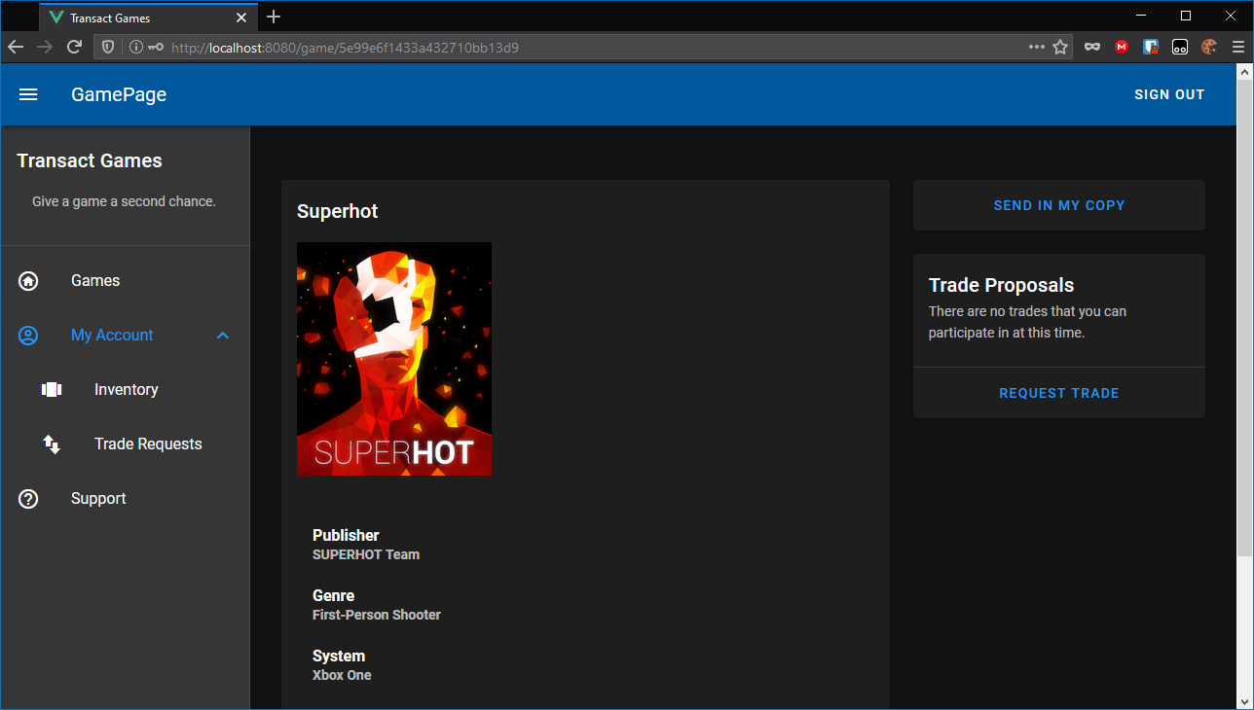
To request a trade, find the game you want, mouse over the “Request Trade” button, and click the game you want to trade.

Slide 15
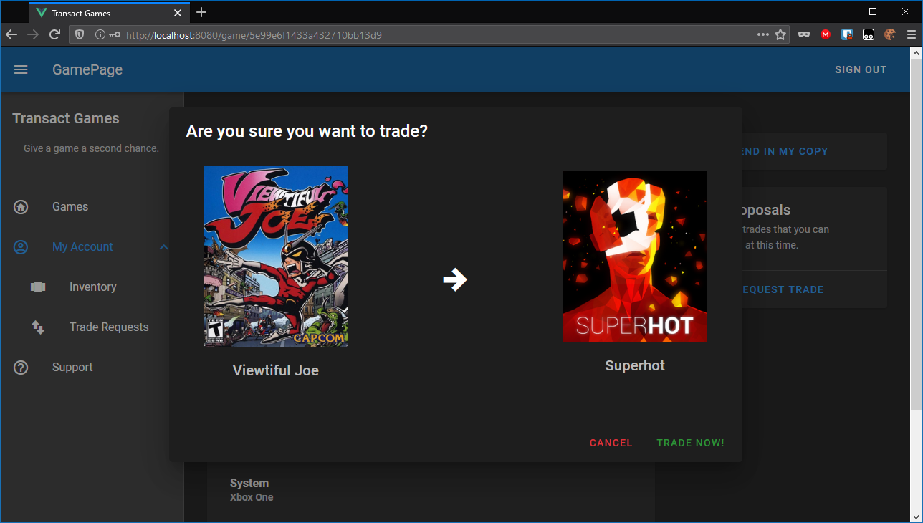
A dialog will ask you if you are sure you want to trade.

Slide 16
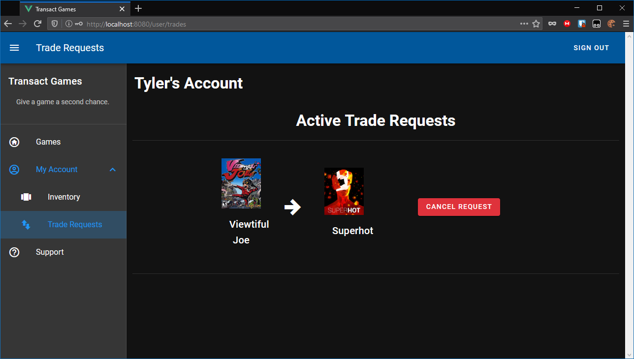
You can manage your active trade requests on the “Trade Requests” page.

Slide 17
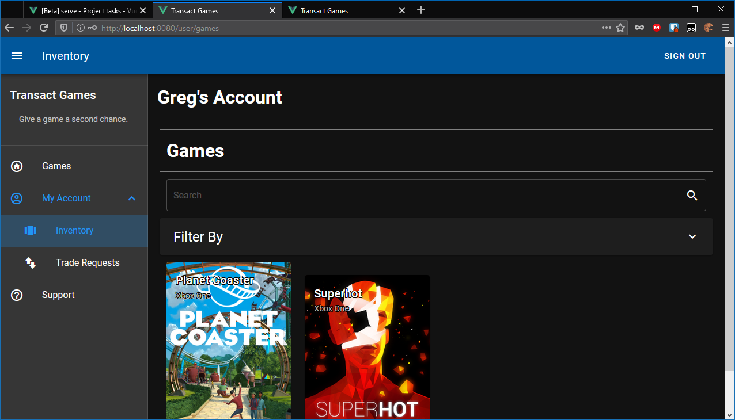
If Greg signs in and has Superhot, he can trade it for Viewtiful Joe.

Slide 18
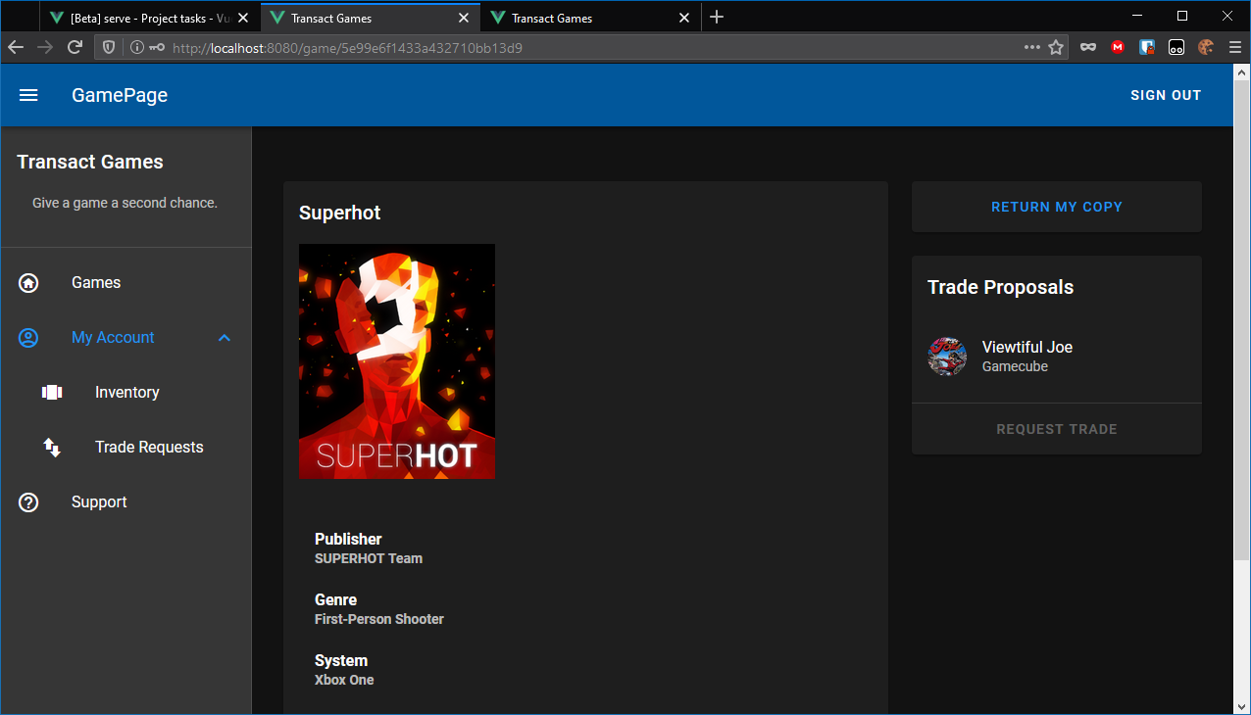
On the Superhot page, Greg can see that someone wants to trade Viewtiful Joe for Superhot.

Slide 19
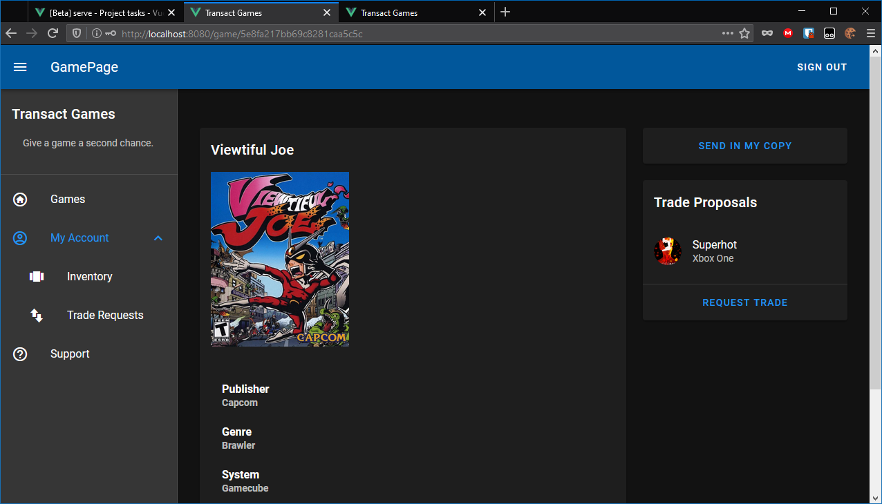
On the Viewtiful Joe page, Greg can see that someone wants to trade Superhot for Viewtiful Joe.

Slide 20
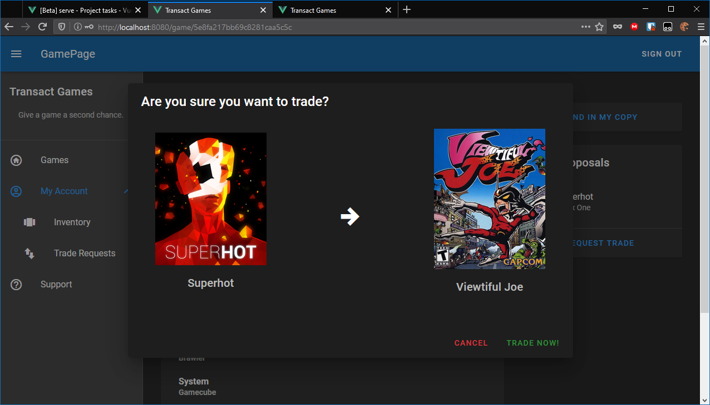
Greg is prompted for the same trade on the Viewtiful Joe page.

Slide 21

As he is on the Superhot page.

Slide 22
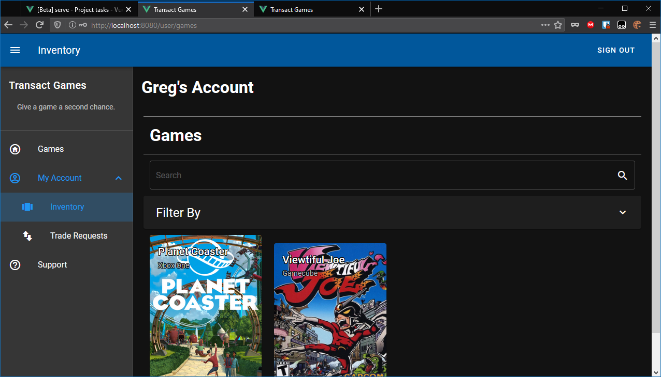
When Greg clicks “Trade Now,” he will get Viewtiful Joe.

Slide 23
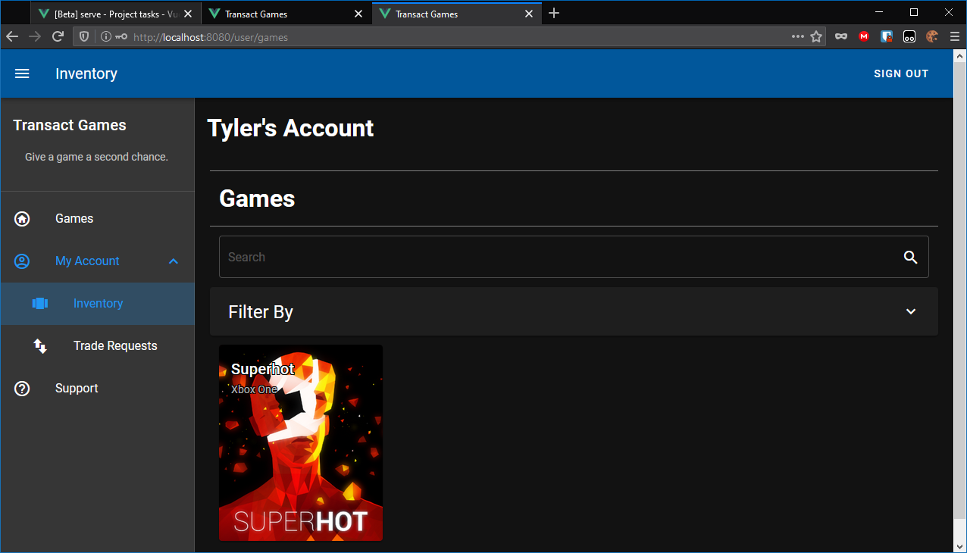
And Tyler will get Superhot.

Slide 24
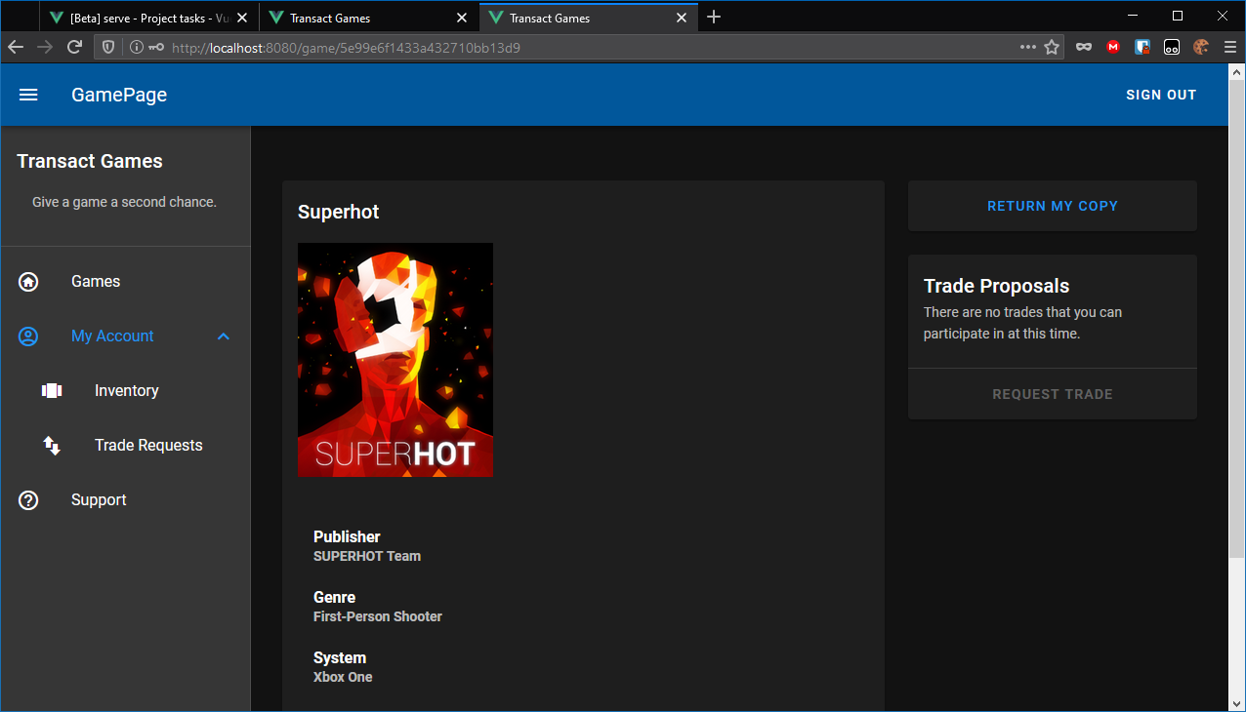
If Tyler wants his new copy of Superhot, he must go to the Superhot page and click “Return my Copy.”

Slide 25
That Concludes the User Guide
That is how you navigate Transact Games.

